Slide 1
Cloud Computing
OWAIS A. HUSSAIN
PhD (candid), PAF-KIET
Sr. Software Engineer & Team Lead, Interactive Health Solutions

Slide 2
Outlines
Introduction
What’s New
Why Cloud?
Cloud Era
DIY
?

Slide 3
What’s new?
Distributed Computing
Networked computers communicating their actions by passing messages
Grid Computing
A collection of computers from multiple locations to reach a common goal; a distributed system with non-interactive workloads
Cloud Computing
A buzz word collection of buzz words
SaaS, PaaS, IaaS

Slide 4
SaaS
Software as a Service
Applications are hosted by vendor or service provider
Made available to customers, typically the Internet
Safe, Crash free, Multi-platform
Examples:
Productivity: Office 365, Google Docs, Picasa Web
Email: Gmail, Outlook
Communication: Skype, GotoMeeting
ERP: SAP, Microsoft Dynamics
Financial: Quicken, Turbotax

Slide 5
PaaS
Platform as a Service
Provide a computer platform, including OS, Programming IDE, Execution environment, Database and Web Server
Real-time resource allocation
Examples:
Amazon: AWS (Amazon Web Services)
Microsoft Azure
Google: App Engine
VMWare: Cloud Foundary

Slide 6
IaaS
Infrastructure as a Service
Physical or Virtual Machines provided to customer
Saves maintenance, security cost
Examples:
Amazon’s EC2 (Elastic Compute Cloud)
Virtual Machines
Firewalls
Web Servers
VLANs

Slide 7
Why Cloud?
Who uses Cloud?
Customer – you
Security
Cost
Reliability
Platform Independency

Slide 8
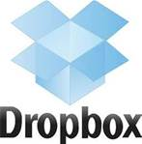






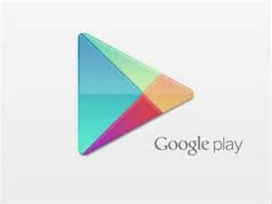










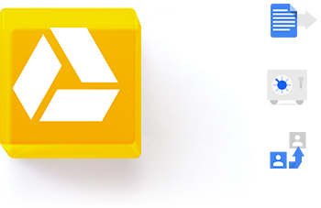




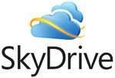
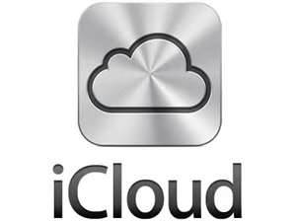










Who uses Cloud?

Slide 9
Why Cloud?
Security
Crash free
Physical Security
Virus Protection
Immune to Absolute Destruction

Slide 10
Why Cloud?
Reliability
No Single POF
High Replication
Tried, Tested & Trusted Hardware
Multiple Physical Locations

Slide 11
Why Cloud?
Platform Independency
Mostly for SaaS
Browser as Client Software
But not entirely true
Mobile Apps
Browser Incompatibilities
Runtime Dependencies (JRE, .NET, Flash)

Slide 12
Cloud Era
Other Applications
Big Data
Facebook

Slide 13
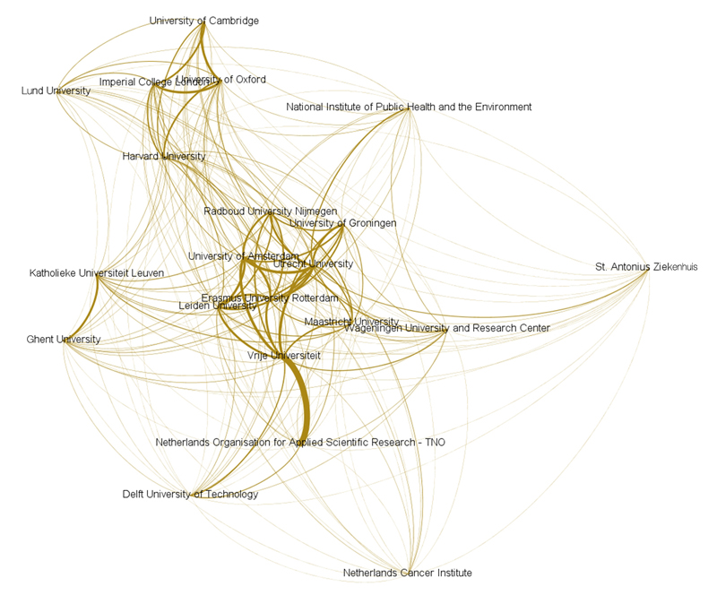
Applications – Network Analysis

Slide 14
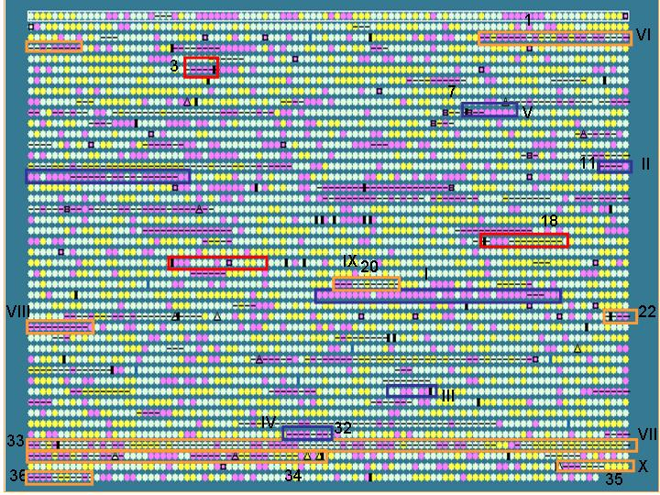
Applications – Genome Sequencing

Slide 15

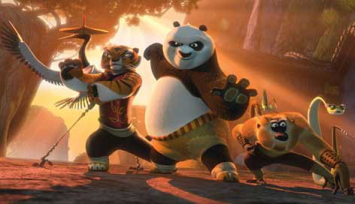
Applications – Video Rendering

Slide 16
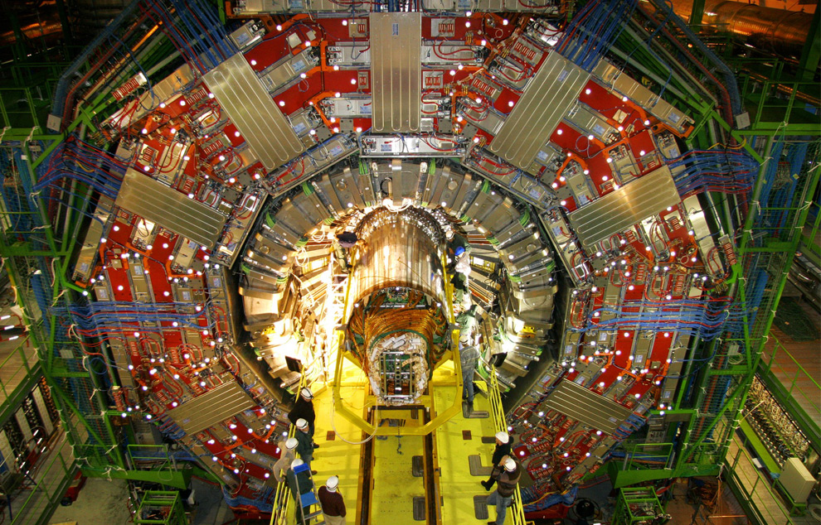
Applications – Particle Science

Slide 17
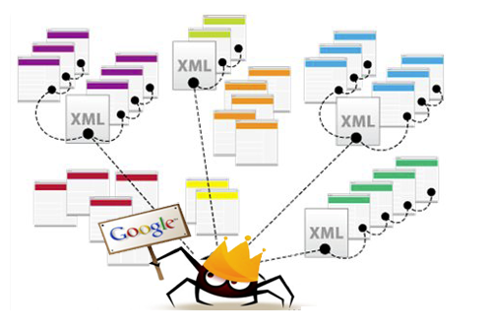
Applications – Web Crawling

Slide 18

Applications – Gaming

Slide 19
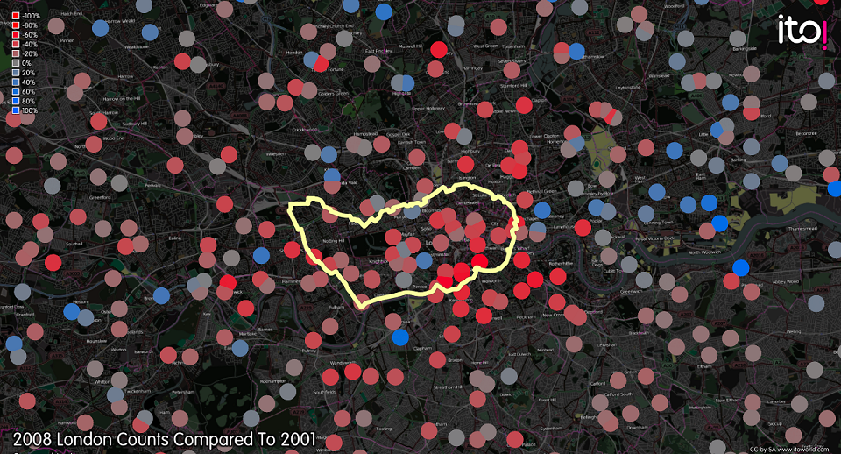
Applications – Traffic Congestion Control

Slide 20
Applications – more..
Flight Simulations – Microsoft Flight Simulator
Augmented Reality – Google Glass
Telecommunications – AT&T et. al

Slide 21
Big Data
Big with a Capital ‘B’

Slide 22
Big Data – Facebook (2012)
2.5B - content items shared
2.7B - ‘Likes’
300M - photos uploaded
100+ PB - disk space in a single HDFS cluster
105TB - data scanned via Hive (30min)
500+ TB - new data ingested

Slide 23
Big Data – Google
Owns 900,000+ servers (2014)
20PB - processed ever day (2008)
850TB - crawler data (2006)
220TB - 2 tables of Google Analytics
10EB - total capacity estimated by XKCD
Btw, 5EB can store every word spoken by mankind

Slide 24
DIY
Hadoop
HIVE
HBase
Pig
Get started…

Slide 25
?

Slide 26
Thank you
For more queries: owaishussain@outlook.com

